Slide 1
Introduction to Multivariable Calculus
Exploring Functions of Multiple Variables

Slide 2
What is Multivariable Calculus?
Multivariable calculus is a branch of calculus that extends the concepts of differentiation and integration to functions with multiple variables.
It involves the study of vectors, partial derivatives, multiple integrals, and vector calculus.
Multivariable calculus provides tools and techniques for analyzing and solving problems in fields such as physics, engineering, economics, and computer science.

Slide 3
Vectors
Vectors are an essential concept in multivariable calculus.
They represent quantities with both magnitude and direction and are used to describe physical quantities such as velocity, force, and displacement.
In multivariable calculus, vectors are used to define and analyze vector fields, which are functions that assign a vector to each point in space.

Slide 4
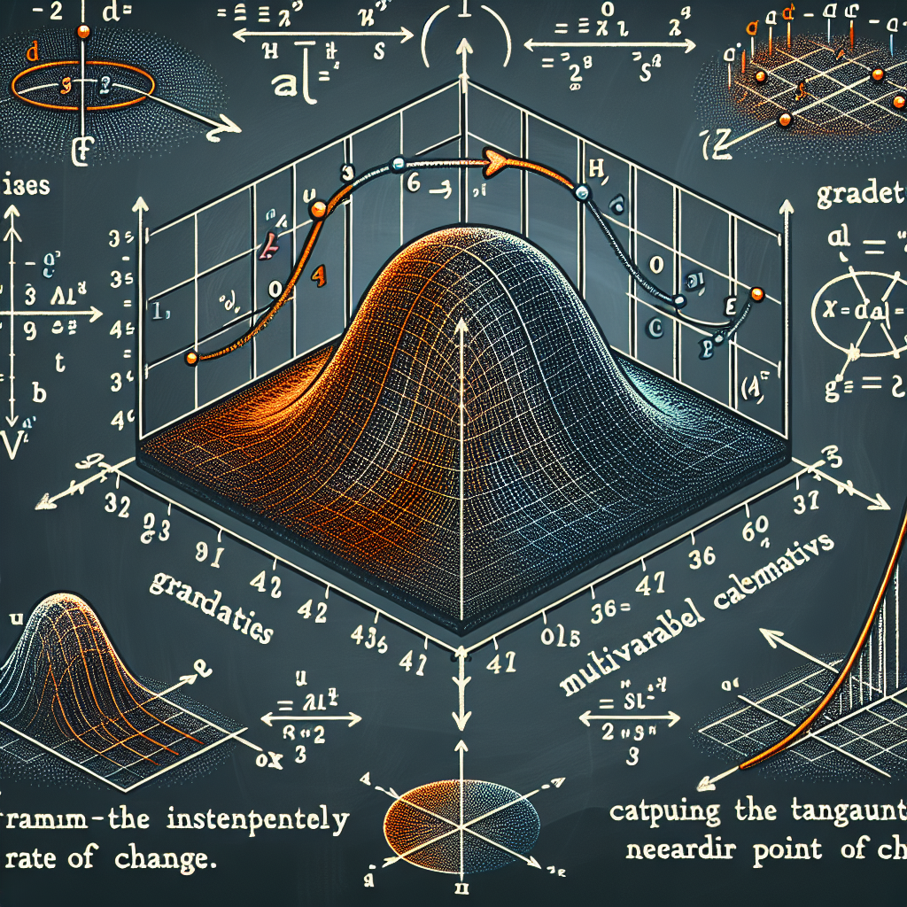
Partial Derivatives
Partial derivatives are a way to measure how a function changes with respect to each of its variables.
They provide information about the rate of change of a function along each coordinate axis.
Partial derivatives are used to calculate gradients, which are vectors that point in the direction of steepest increase of a function, and tangent planes to surfaces.
Partial Derivatives

Slide 5
Multiple Integrals
Multiple integrals generalize single-variable integrals to functions of multiple variables.
They are used to calculate volumes, areas, and other quantities in higher-dimensional spaces.
Multiple integrals can be evaluated using techniques such as iterated integrals and change of variables.

Slide 6
Vector Calculus
Vector calculus is a branch of calculus that deals with vector fields and line integrals, surface integrals, and volume integrals of vector fields.
It provides tools for studying the behavior of vector fields, such as flux, circulation, and the divergence and curl of vector fields.
Vector calculus is used in various fields, including physics, fluid dynamics, and electromagnetism.

Slide 7
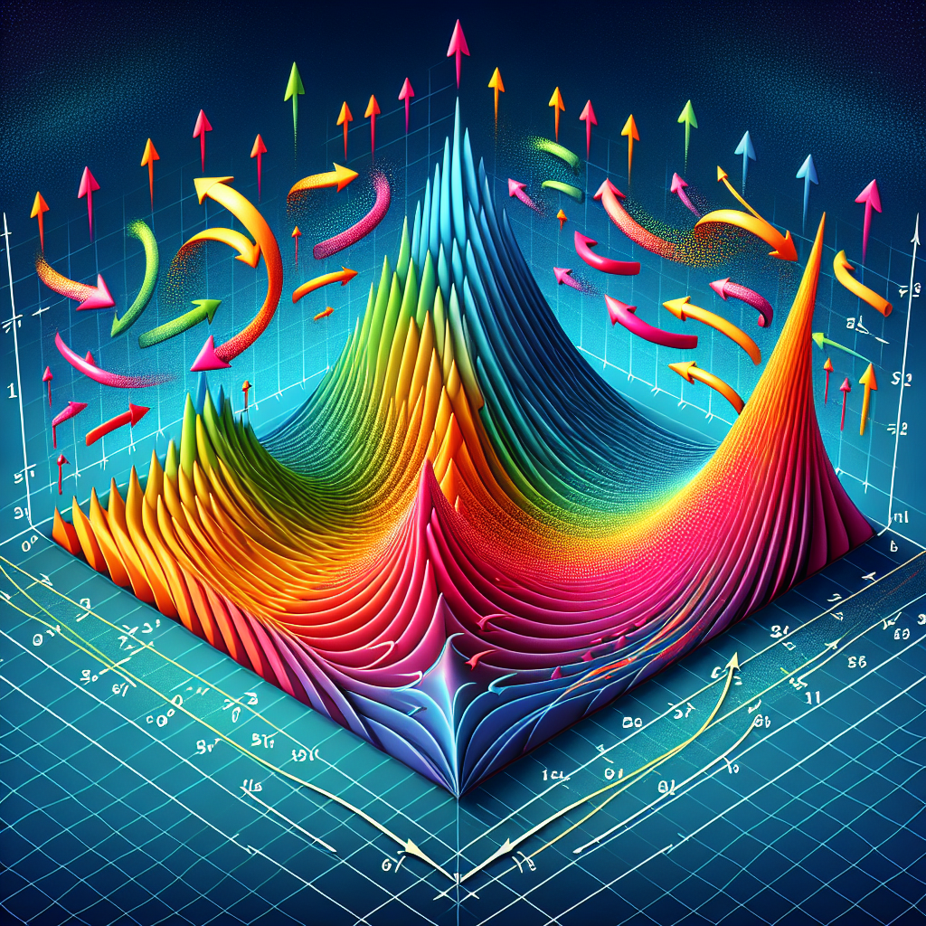
Gradient, Divergence, and Curl
Gradient, divergence, and curl are important concepts in vector calculus.
The gradient measures the rate of change of a scalar function in space and points in the direction of steepest increase.
The divergence measures the tendency of a vector field to converge or diverge at a given point, and the curl measures the tendency of a vector field to circulate around a point.
Gradient, Divergence, and Curl

Slide 8
Parametric Surfaces
Parametric surfaces are surfaces that can be parameterized by two variables.
They are described by functions that assign a point in space to each point of a two-dimensional domain.
Parametric surfaces are used to represent surfaces in three-dimensional space and are important in fields such as computer graphics and geometric modeling.

Slide 9
Line Integrals
Line integrals are integrals along curves in space.
They are used to calculate quantities such as work, circulation, and flux of vector fields along curves.
Line integrals can be evaluated using techniques such as parameterization and the fundamental theorem of line integrals.

Slide 10
Surface Integrals
Surface integrals are integrals over surfaces in space.
They are used to calculate quantities such as flux and surface area of vector fields over surfaces.
Surface integrals can be evaluated using techniques such as parameterization and the divergence theorem.

Slide 11
Volume Integrals
Volume integrals are integrals over regions in three-dimensional space.
They are used to calculate quantities such as volume, mass, and center of mass of solid objects.
Volume integrals can be evaluated using techniques such as triple integrals and the divergence theorem.

Slide 12
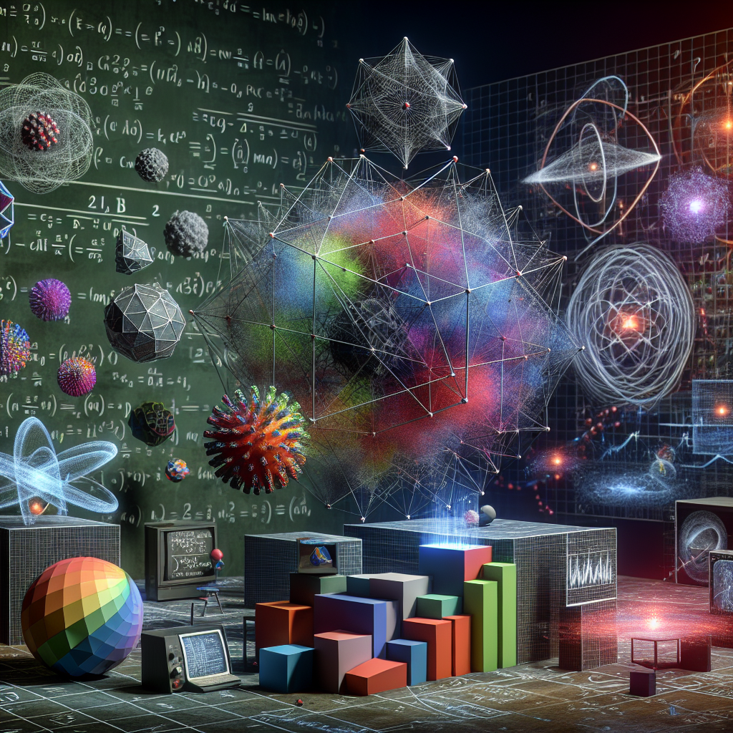
Applications of Multivariable Calculus
Multivariable calculus has numerous applications in various fields.
In physics, it is used to study fluid flow, electromagnetism, and gravitational fields.
In economics, it is used to model and analyze systems with multiple variables and constraints.
In computer graphics, it is used to render 3D images and animations.
Applications

Slide 13
Partial Differential Equations
Partial differential equations (PDEs) are equations that involve partial derivatives of unknown functions.
They are used to describe a wide range of physical phenomena, such as heat conduction, fluid flow, and electromagnetic fields.
Solving PDEs often requires knowledge of multivariable calculus techniques and can lead to insights into the behavior of complex systems.

Slide 14
Optimization
Optimization is the process of finding the best solution for a given problem.
In multivariable calculus, optimization involves finding maximum or minimum values of functions subject to constraints.
Optimization techniques are used in fields such as engineering, finance, and operations research to optimize system performance and resource allocation.

Slide 15
Vector Analysis
Vector analysis is a branch of mathematics that deals with vector fields and the operations that can be performed on them.
It includes concepts such as gradient, curl, divergence, and line, surface, and volume integrals.
Vector analysis provides a powerful mathematical framework for studying and analyzing physical phenomena in multiple dimensions.

Slide 16
Curvilinear Coordinates
Curvilinear coordinates are coordinate systems in which the coordinate lines are curved.
They are used to describe points in space using coordinates other than the usual Cartesian coordinates.
Curvilinear coordinates are particularly useful in solving problems with symmetry or in physical systems with non-Cartesian geometries.

Slide 17
Taylor Series Expansion
Taylor series expansion is a way to express a function as an infinite sum of terms.
It allows for approximating functions using polynomials and is used in numerical analysis, physics, and engineering.
Taylor series expansions can provide accurate approximations for functions in a neighborhood of a specific point.

Slide 18
Magnetic Fields
Magnetic fields are vector fields that represent the magnetic influence of electric currents and magnetic materials.
They are described using concepts from vector calculus, such as curl and divergence.
Magnetic fields have applications in various fields, including electromagnetism, telecommunications, and medical imaging.

Slide 19
Stokes' Theorem
Stokes' theorem relates a surface integral of a vector field to a line integral along the boundary of the surface.
It is a fundamental result in vector calculus and provides a connection between line and surface integrals.
Stokes' theorem has applications in physics, engineering, and fluid dynamics.

Slide 20
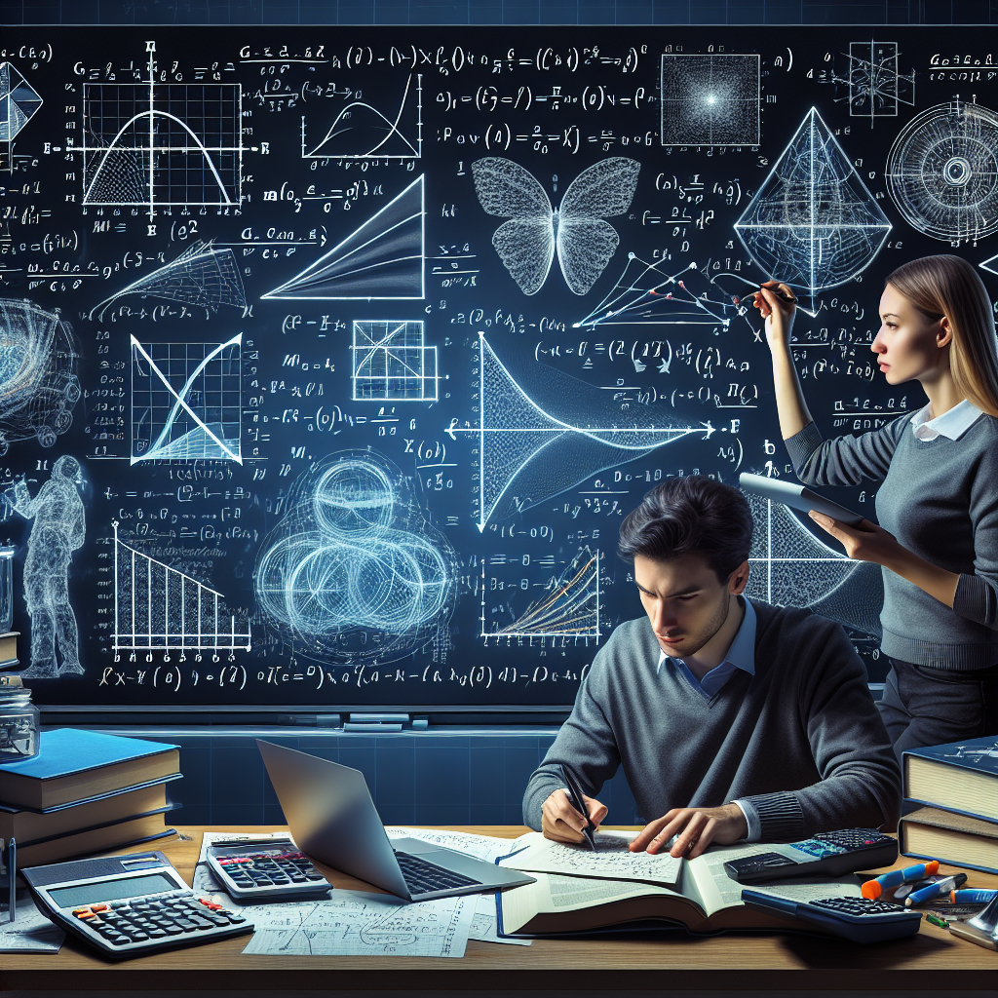
Conclusion
In conclusion, multivariable calculus is a powerful branch of mathematics that extends the concepts of differentiation and integration to functions with multiple variables.
It provides tools for analyzing and solving problems in various fields, including physics, engineering, economics, and computer science.
By studying multivariable calculus, we gain insights into the behavior of complex systems and develop techniques for optimization, vector analysis, and solving partial differential equations.
Multivariable Calculus

